Slide 1
INFO 7390 – Midterm – Zillow Data Set
Team 7
Devesh & Soham

Slide 2
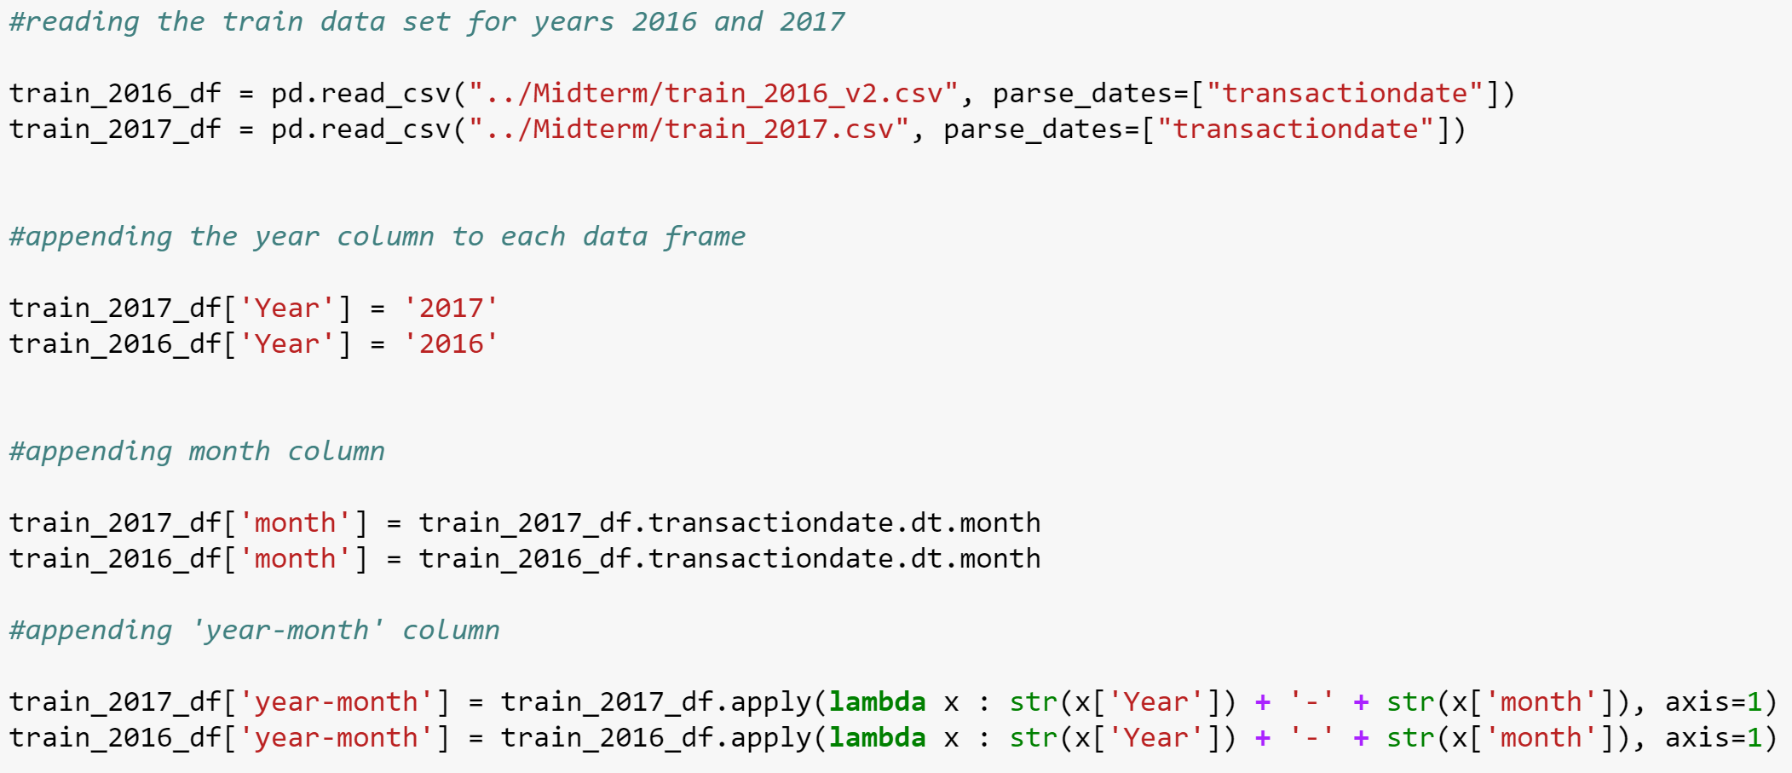
Data Ingestion, EDA and Wrangling
Ingestion
Loaded the train data set for years 2016 and 2017
Loaded the property data sets for years 2016 and 2017
Merged the files and added a column for the year

Slide 3
Exploratory Data Analysis and Data Wrangling
Plotting Histogram and Box Plot of Log errors to see the distribution and anomalies
Trend analysis of log error with monthly sales transactions
Missing data analysis
Using threshold values for eliminating data( 70%)
Removing the outliers of the log error based on box plot inference
Supervised learning algorithm
Nearest Centroid to predict categorical information
Eg. Using Latitude and Longitude to predict Region-Neighborhood-Id
K-Nearest Neighbors Classifiers
Eg. Using finishedsquarefeet12, buildingqualitytypeid, lotsizesquarefeet and regionidneighborhood to predict heatingorsystemtypeid

Slide 4
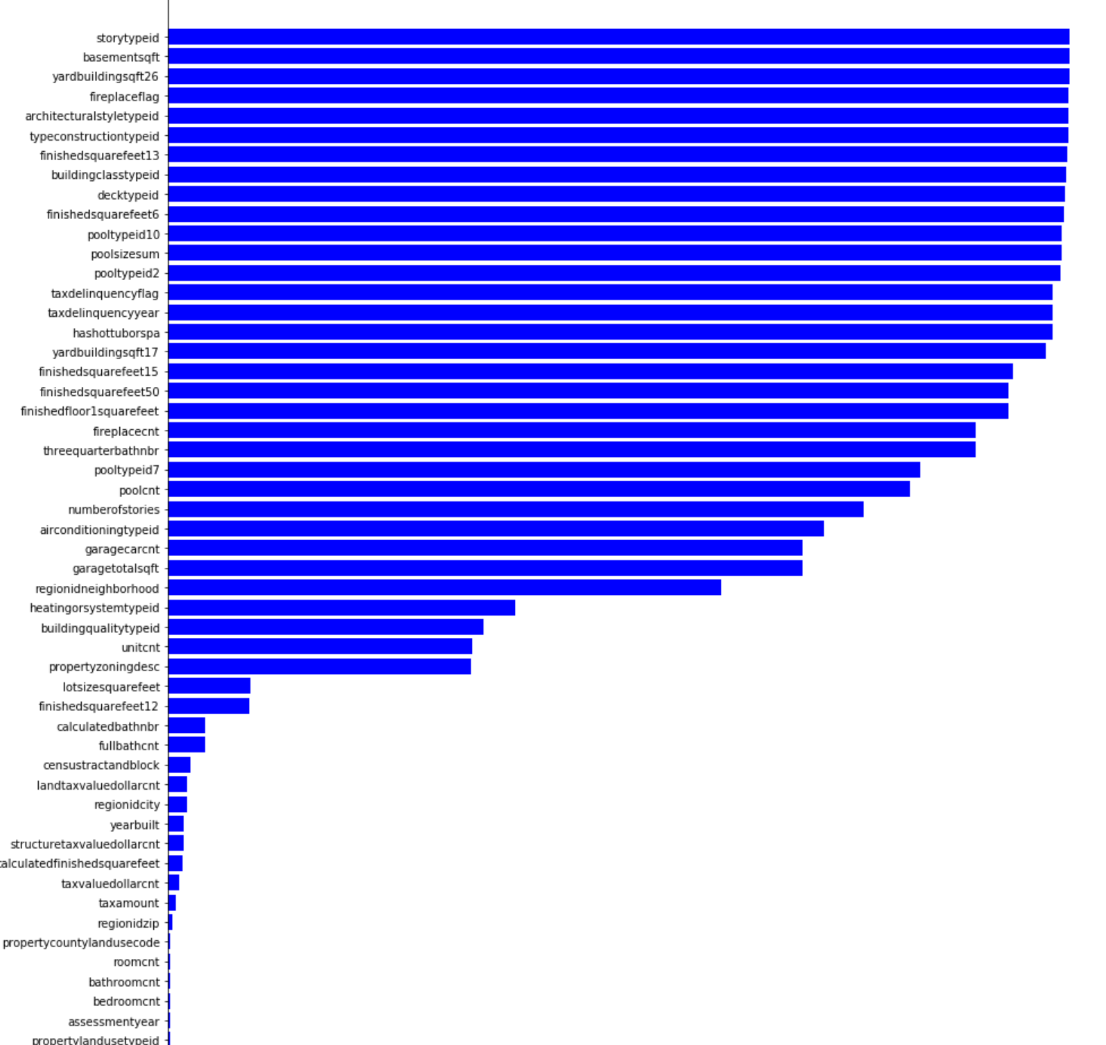
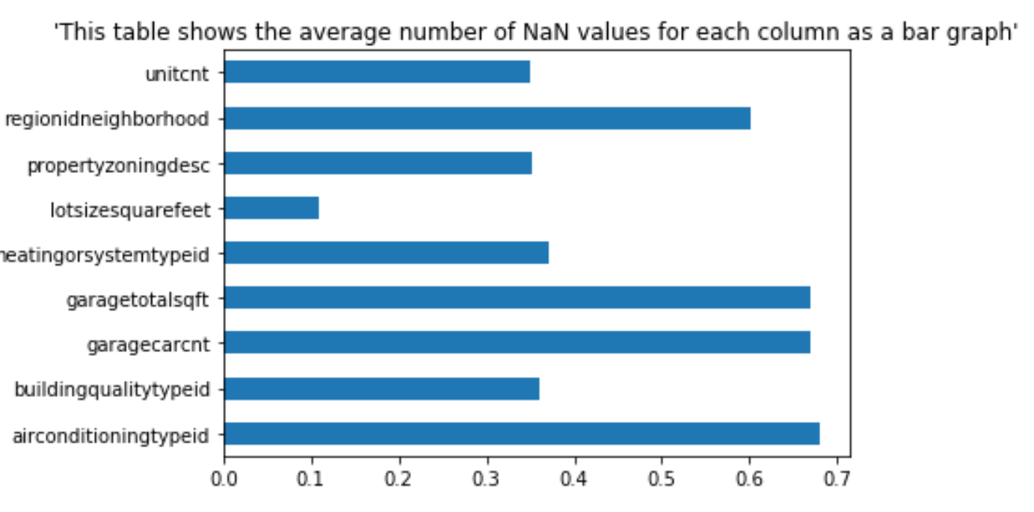

Slide 5
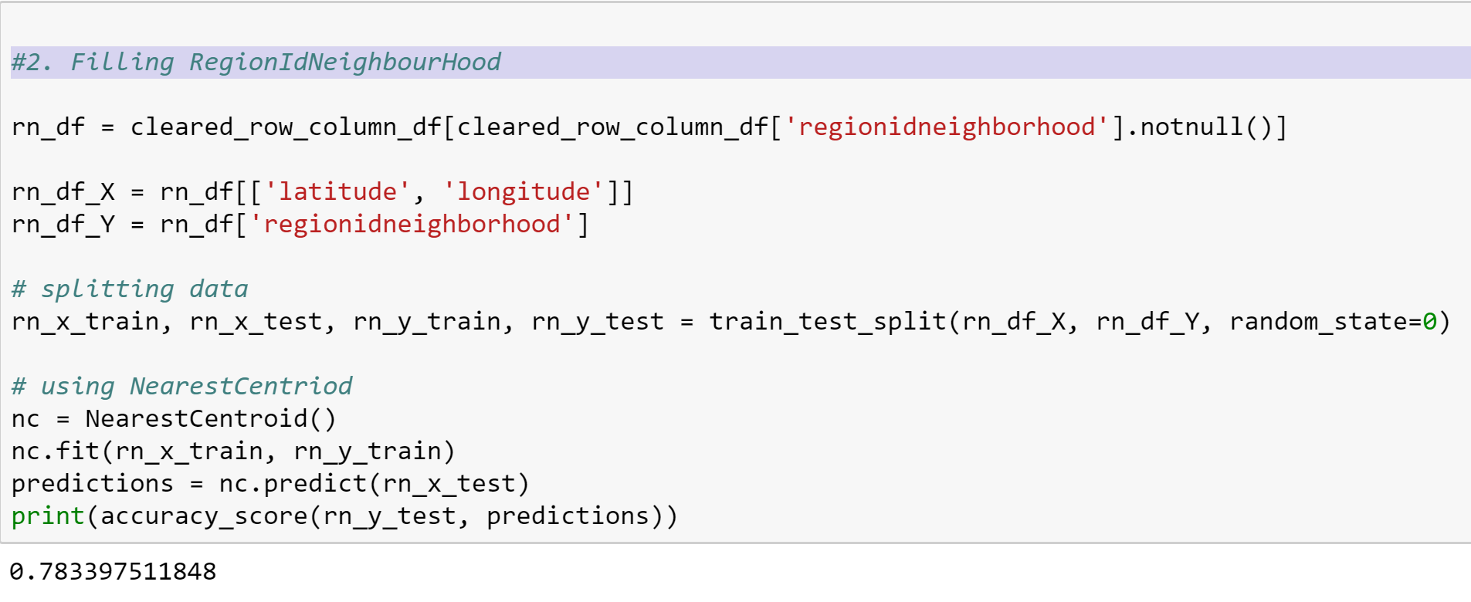

Slide 6
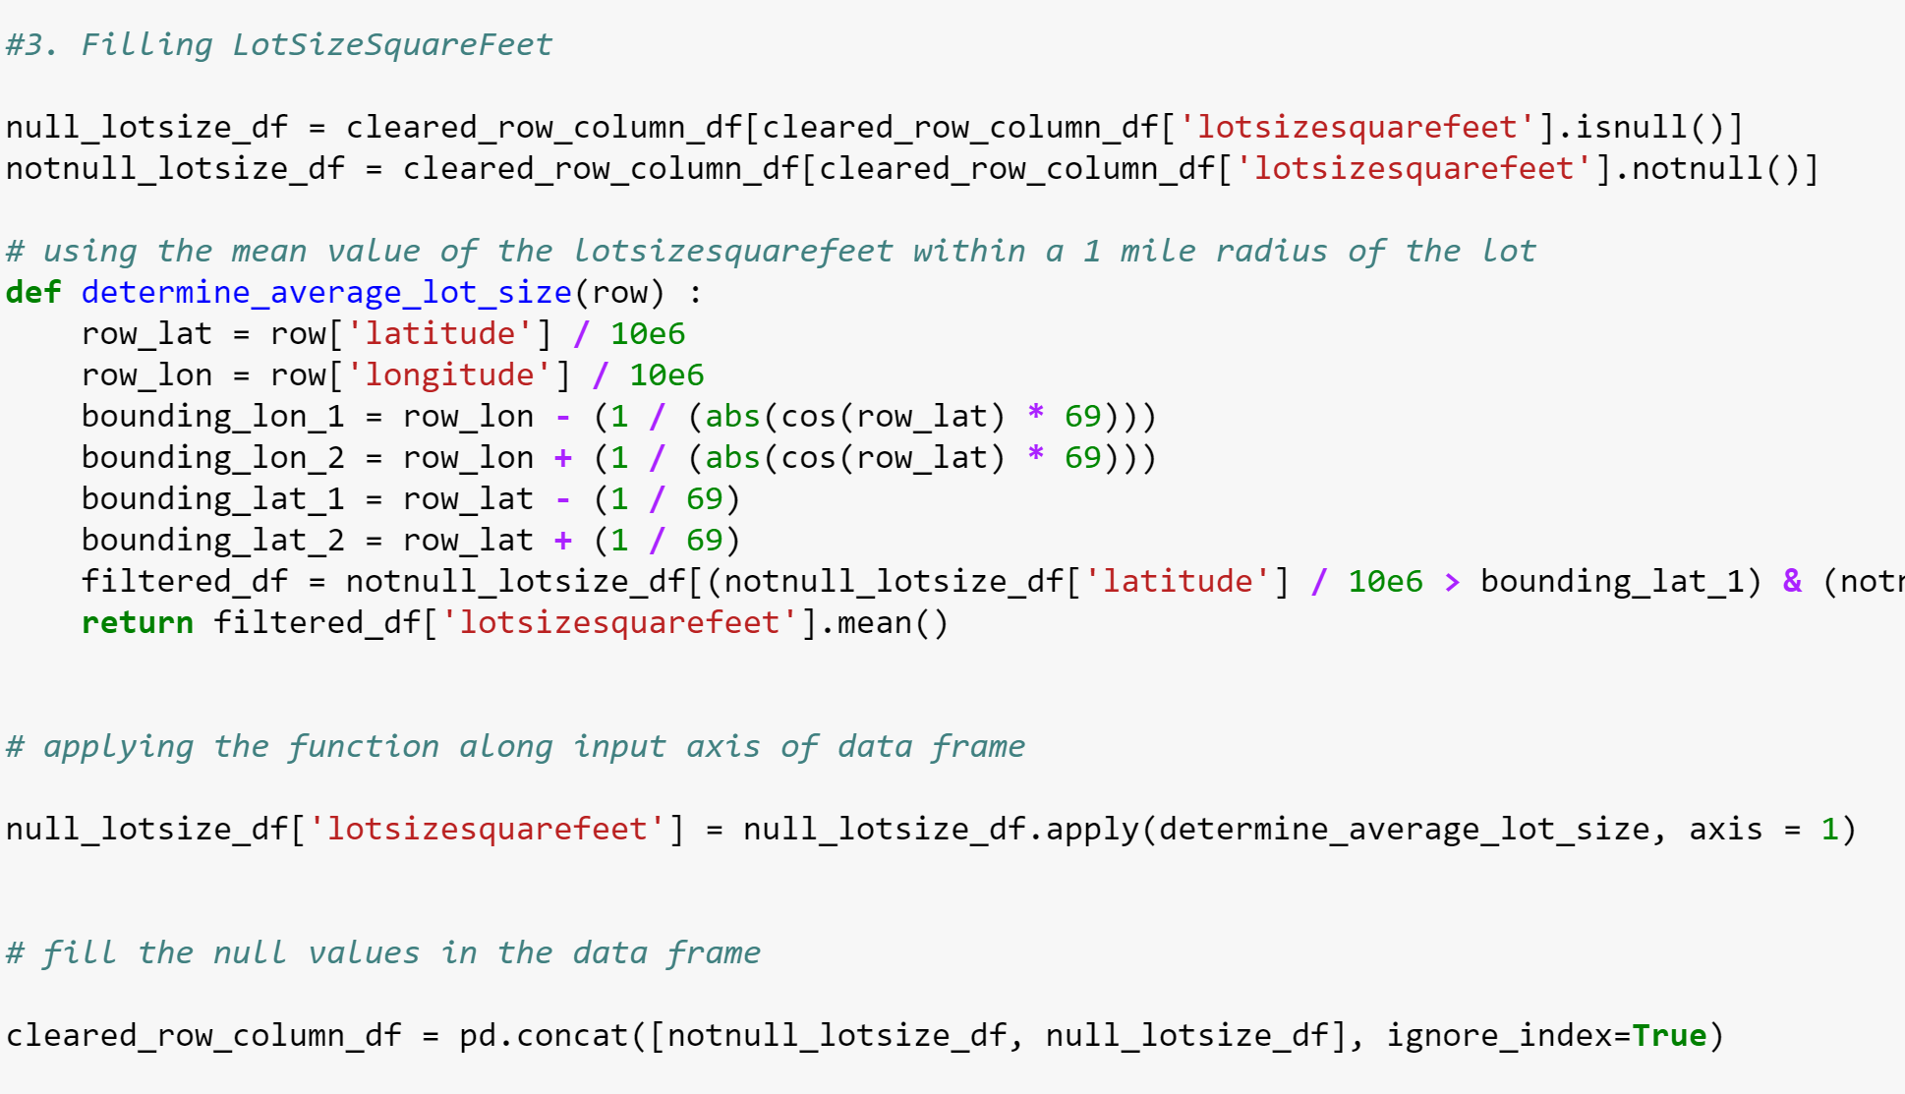
Using geo spatial information to predict lotsizesquarefeet

Slide 7
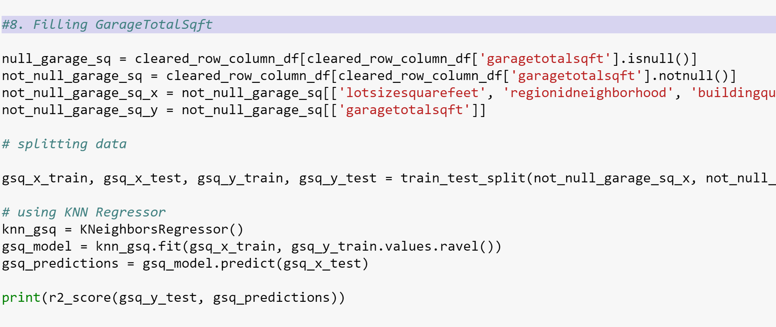
Using K-Nearest Regression to fill the missing values

Slide 8
Prediction Model
Multiple Linear Regression
MAE – 0.02980
RMS – 0.03786
Computational Overhead – Least
Random Forest Regressor
MAE – 0.02974
RMS – 0.03779
Computational Overhead – Depends upon maximum depth level of the tree
Neural Network
MAE – 0.0306
RMS – 0.0015
Computational Overhead – Depends upon the number of hidden layers and epoch interval set for training the model, takes the maximum amount of time
BEST MODEL – Random Forest Regressor

Slide 9
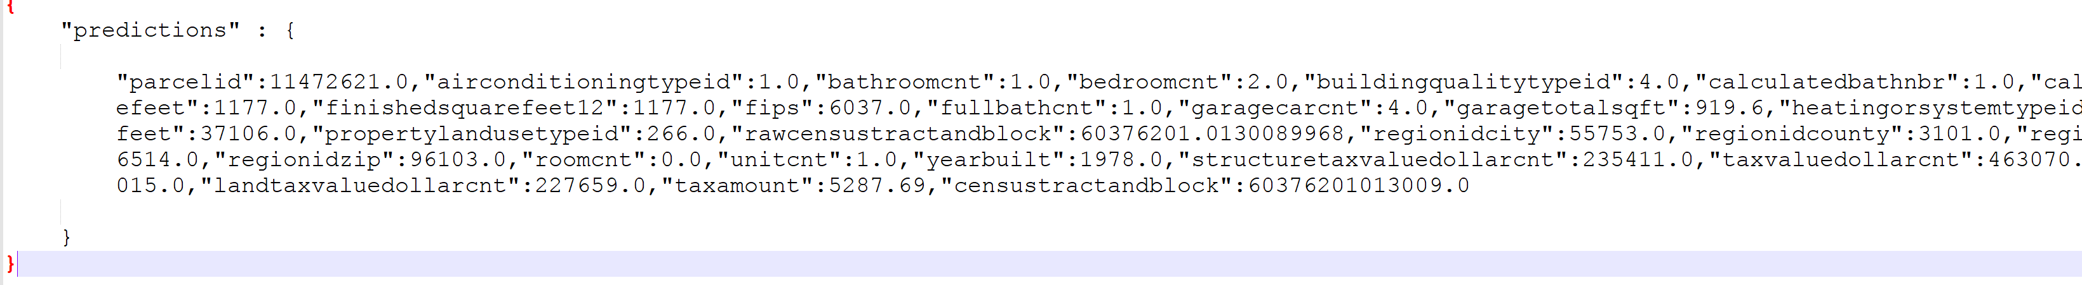
Model Deployment – Google Cloud Platform
Uploaded the best model and property spatial data on Google Cloud
Uploaded the cleansed data on Amazon S3
URL - https://s3-sa-east-1.amazonaws.com/zillow-data1/zillow_data_cleaned.csv
Log error prediction service
Method – http – POST
URL – http://35.192.35.231:8000/predict
Body –
Response – { "parcelid": 11472621, "prediction-value": 0.011608385558027172 }

Slide 10
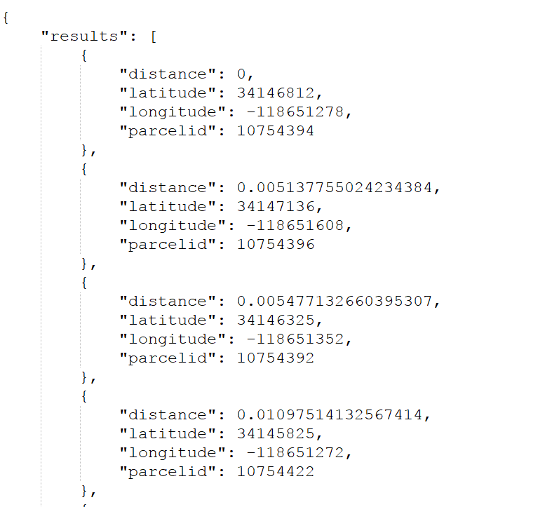
Geospatial Search
Geospatial Search Service – find all locations within a fixed radius from the requested latitude and longitude, if less than 10 records found then double the search radius. Compute the haversine distance and return top 10 results.
Method – http – GET
URL – http://35.192.35.231:8000/search/{latitude}/{longitude}
Body –

Slide 11
